Slide 1
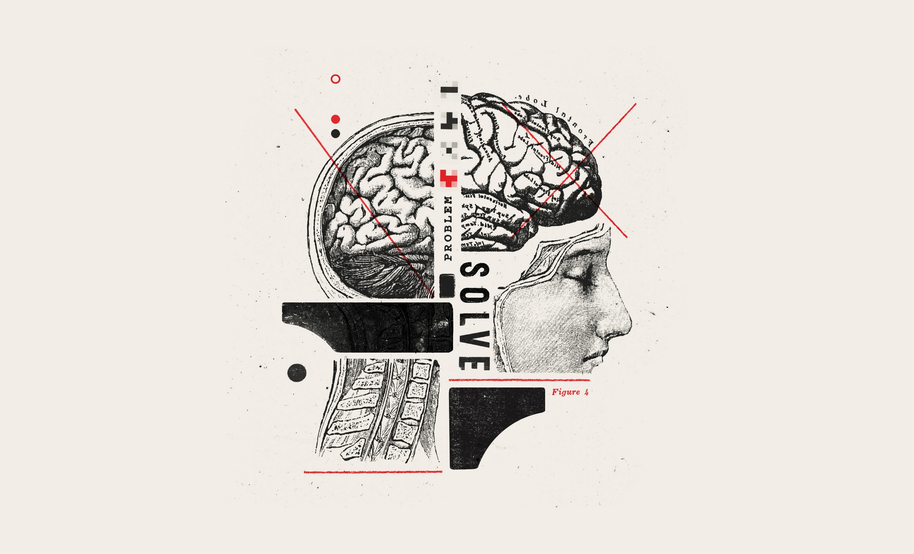
In 10 minutes
DESIGN
THINKING

Slide 2
desain thinkinG
Design thinking adalah metode menyelesaikan masalah dengan pendekatan yang berpusat-pada- pengguna (user-centered).

Slide 3
Kenapa menggunakan design thinking?
Mengurangi resiko sebelum meluncurkan ide baru
Mempercepat proses pembelajaran
Menghasilkan solusi yang inovatif, bukan cuma inkremental

Slide 4
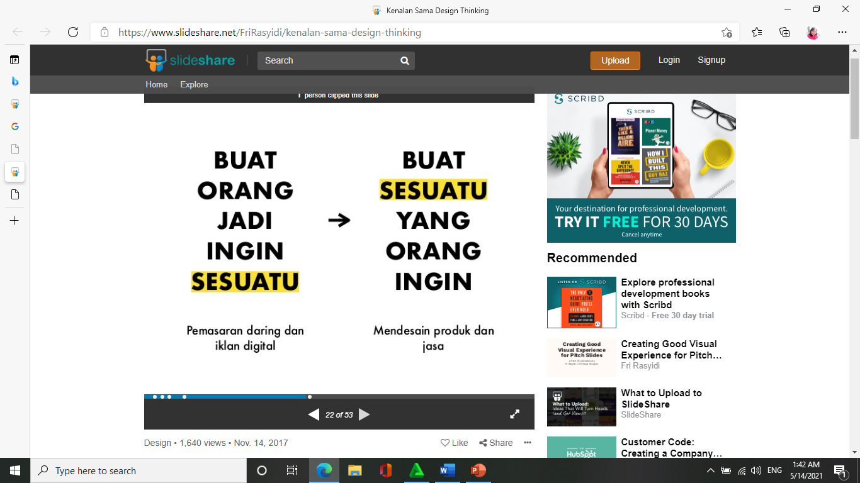

Slide 5
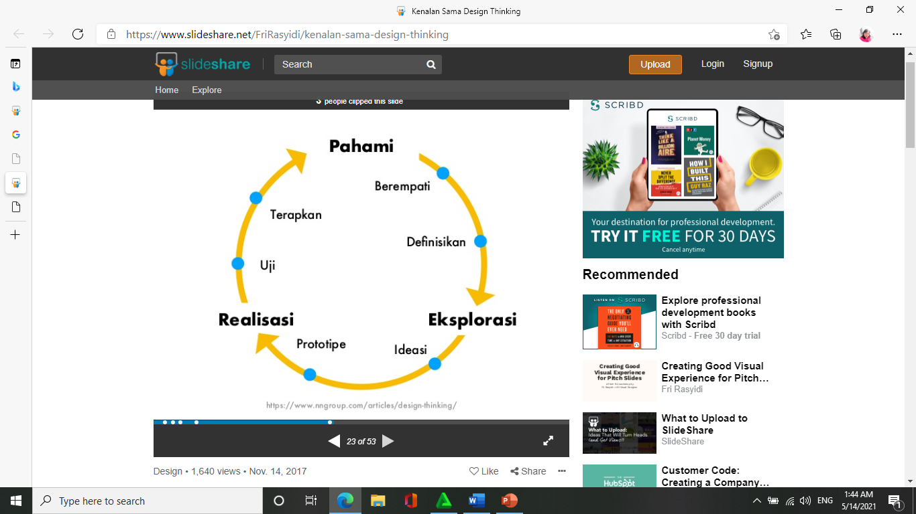

Slide 6
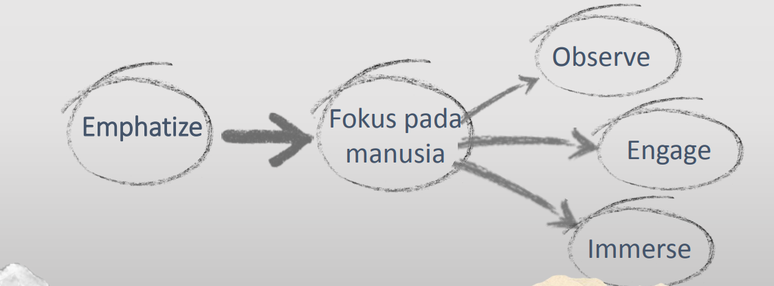

Slide 7
Design Thinking
Empathize with people's needs,
01
Collaborate with others across disciplines, skill sets, and perspectives,
02
Include every idea in visible form for evaluation, and
03
Repeat, iterating and testing solutions to perfect them, always with human needs at the center.
04

Slide 8
Desain pengalaman pengguna (user experience design)
rancangan perjalanan pengguna dari awal mereka berﬁkir tentang masalah hingga mencapai objektifnya.

Slide 9
Mantra desain pengalaman pengguna
• buat jadi bekerja (make it work);
• buat jadi simpel (make it simple);
• buat jadi indah (make it beautiful).

Slide 10
Design Thinking Process - Ideation
Brainstorm Ideas
Select top 2 or 3
Storyboard
"How Might We...?"

Slide 11
Design Thinking Process – Implementation
Design Experiments
Iterate
Test

Slide 12
Design Thinking Process to Reframe a Problem
How might we…
Why do we want to do that?
What is stopping us from doing that?
Revise: How might we...?
Has our concept of the problem changed?

Slide 13
Tools We Use
Fly on the Wall Observation
Contextual Inquiry
One-On-One Interview
Expert Interview
Group Interview/Focus Groups
5 Why (Root Cause/Fishbone or Ishikawa Diagram)
Design Charrettes
Service Blueprinting

